Slide 1
Our Topology
s2
eth2
s3
eth1
eth2
eth1
eth2
eth2
h1
eth1
s1
s4
eth1
h2
eth1
eth1
eth3
eth3
s5
eth1
eth2

Slide 2
Source Routing Forwarding
Traditional forwarding:
Distributed routing decision
Switches forward pkts by looking up table (IP - port)
Our work (source routing):
Hosts know the whole path
Hosts build path in pkt headers
Switches forward pkts following path in their headers
OpenFlow 1.3
Repurpose vlan tag in 802.1Q headers to store path

Slide 3
Source Routing Header
ICMP packet headers
Ethernet: dst=xx:xx:xx:xx:xx:xx src=xx:xx:xx:xx:xx:xx
MAC address: not important
Multiple nested 802.1Q headers
Normal ICMP header structure
802.1Q: vlan=out_port
...
802.1Q: vlan=out_port
IPV4: dst=dst_ip src=src_ip
ICMP: id=xxx seq=seq_num
Payload

Slide 4
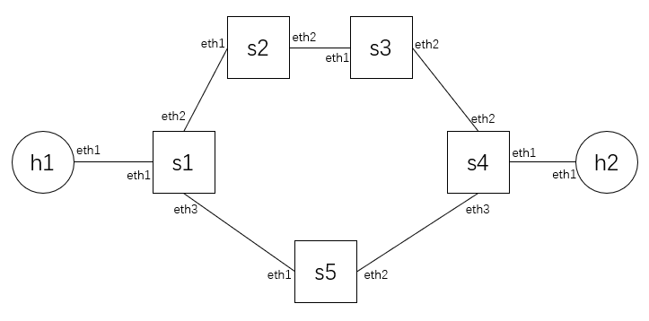
Flow Entries
s1 flow table
..., table=0, n_packets=0, n_bytes=0, priority=2000,
dl_vlan=1 actions=pop_vlan,output:"s1-eth1“
..., table=0, n_packets=0, n_bytes=0, priority=2000,
dl_vlan=2 actions=pop_vlan,output:"s1-eth2“
..., table=0, n_packets=0, n_bytes=0, priority=2000,
dl_vlan=3 actions=pop_vlan,output:"s1-eth3"

Slide 5
Example
h1 ping h2
Path: h1 - s1-s5-s4 - h2
Out ports: eth3-eth2-eth1 = [3, 2, 1]
Ethernet
Ethernet
Ethernet
Ethernet
802.1Q: vlan = 3
802.1Q: vlan = 2
802.1Q: vlan = 1
IPV4
802.1Q: vlan = 2
802.1Q: vlan = 1
IPV4
ICMP
802.1Q: vlan = 1
IPV4
ICMP
Payload
IPV4
ICMP
Payload
ICMP
Payload
Payload

Slide 6
AI Utilization
Generate code template: Claude, Gemini
Code testing and debugging: Claude, Gemini
GUI Generation and Connection: Claude

